Slide 1
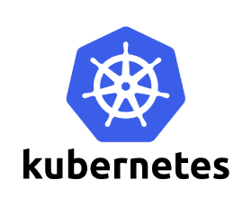

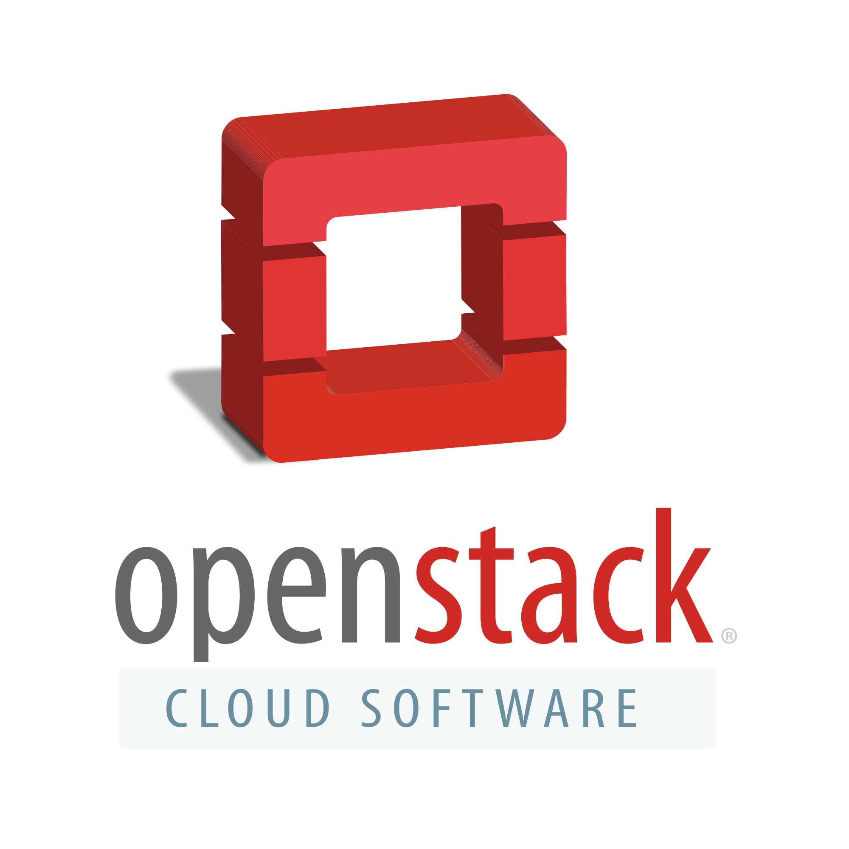




OpenSDS POC Networking Suggestion
OpenSDS
Data Mobility App.
Data Provisioning
Data Mobility
Intelligent Operation
Dock
OpenSDS Native driver
Host
CMS Agent
Host
CMS Agent
3rd party SDS
Storage
（Block）
EC2
Agent
EBS

Slide 2
CMS Introduction
Physical Machine
Physical Machine
CLOUD HOST
CLOUD HOST
Virtual Machine
Virtual Machine
CMS
【Cloud Migration Service 】

Slide 3



CMS Technology
APP
TCP/IP
DATA
APP
OS
OS
DATA
Block Driver
APP
VM
OS
CMS
Agent
DATA
Source
Hardware
APP
Target
OS
1. Analyzing disks
4. Incremental Synchronization
2. Rebuilding Volumes
5. Update Drivers
3. Mirroring data
6. Workload Switching

Slide 4



Data Mobility: Data Migration Between Clouds
OpenSDS
CMS
Cloud
OpenSDS Dock
Target
CMS Driver
OpenSDS Controller
Target
Enlarged View;
Migration Profile
Storage
Source
OpenSDS Dock
CMS Driver
Data Migration for Block Device
Storage

Slide 5
Data Mobility: OS Migration Between Clouds—All-in-One
OpenSDS
CMS
Cloud
OpenSDS Dock
Target
CMS Driver
OpenSDS Controller
Target
Enlarged View;
Migration Profile
Storage
Source
OpenSDS Dock
CMS Driver
Online Migration for OS
Storage

